Slide 1
User centered design

Slide 2
HCI and Design
Rather than the traditional design models adopted within software engineering which are characterized by their linearity. HCI has adopted a design model which aspires to incorporate the following premises:
* user centered
* multi disciplinary
* highly iterative

Slide 3
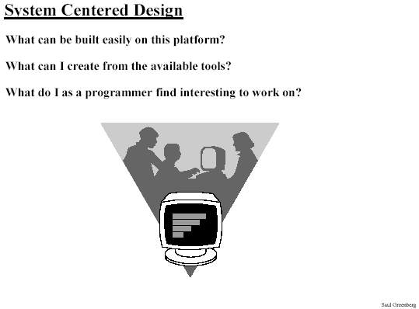
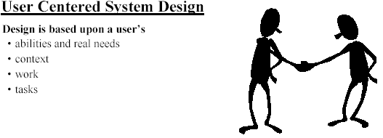

Slide 4
What is User-Centered Design?
Is an approach to interactive system development that focuses specifically on making products/web interfaces usable.
The quality of interaction between the person who uses the product to achieve actual work and the product itself is the primary goal of user-centered design.
User-centered systems empower users and motivate them to learn and explore new system solutions

Slide 5
Principles of human-centered design:
Active involvement of users
Appropriate allocation of function between user and system
Iteration of design solutions
Multidisciplinary design teams
Essential activities in human-centered design:
Understand and specify the context of use
Specify the user and organizational requirements
Produce design solutions (prototypes)
Evaluate designs with users against requirements

Slide 6
The user-centered design methodology is characterized by:
* the involvement of users throughout the design process
* the use of an iterative design cycle

Slide 7
There are four basic activities in Interaction Design:
1. Identifying needs and establishing requirements
2. Developing alternative designs
3. Building interactive versions of the designs
4. Evaluating designs

Slide 8
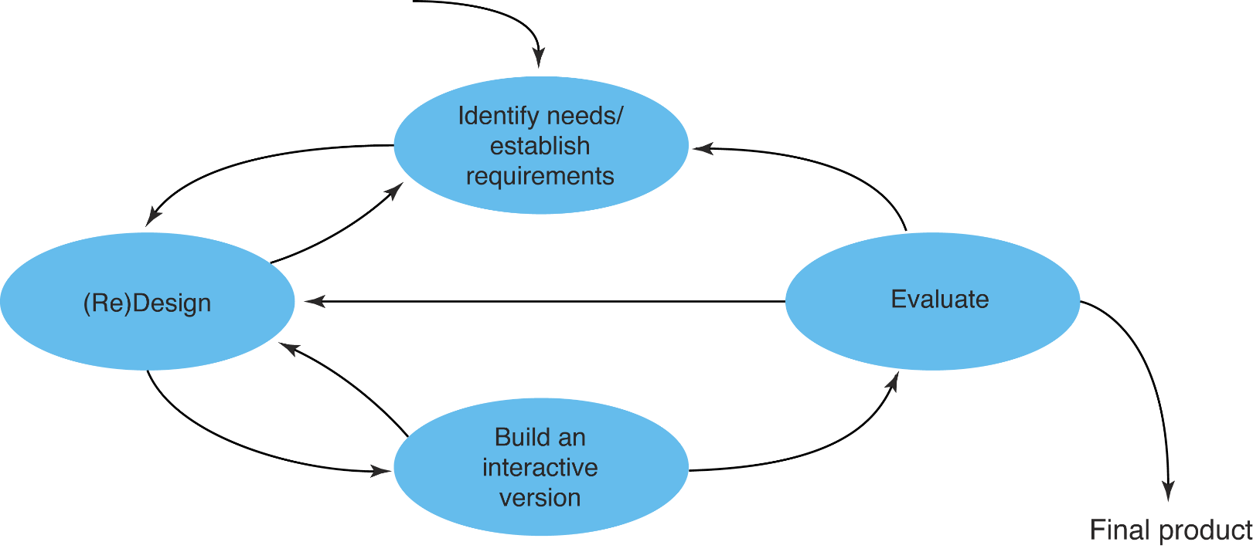
A simple interaction design model

Slide 9
The involvement of users throughout the design process: An example of web design
Reference: http://www.its.monash.edu.au/web/slideshows/ucd/spusc.html
Empowering users through user-centered web design by Dev Alexander
Focus on users
There are a number of ways in which user participation can be facilitated throughout the design process:
Focus groups, Questionnaires and Interviews, Observation,
User testing, and many more …
more information at http://www.usableweb.com
Focus on user
Methods for involving the users

Slide 10
The Use of an iterative design cycle
Iterative design is a process where an interface is progressively developed and improved over a series of iterations, each the result of user testing and feedback.
In its simplest form, the iterative design cycle can be said to have three phases: design, test, redesign. These phases operate in a continual cycle (in theory that is; in practice iterations are limited by budgetary considerations) so that designs are continually evaluated and improved.

Slide 11
Key aspects of user-centered design:
* Early focus on users, tasks and environment
* The active involvement of users
* An appropriate allocation of function between user
and system
* Iterative design whereby a prototype is designed,
tested and modified
* Multi-disciplinary design teams

Slide 12
Early focus on users, tasks and environment:
The characteristics of the intended users
The tasks the users will perform
The environment in which the users will use the system

Slide 13
An appropriate allocation of function between user and system:
Determining which aspects of a task should be handled by people and which can be handled by software and hardware is of critical importance. (Task Allocation)
The allocation of function should be based on an appreciation of human capabilities, and their limitations.
This allocation benefits from the input of end-users which will also help to ensure that the results are acceptable to the people who will be affected.

Slide 14
The active involvement of users:
The key strength of user-centered design
Involving end-users can also enhance the acceptance and commitment to the new software as staff some to feel that the system is being designed in consultation with them rather than being imposed on them.

Slide 15
Iterative design whereby a prototype is designed, tested and modified / Iterative of design solutions:
The users attempt to accomplish ‘real world’ tasks using the prototype and the feedback from the exercise is used to develop the design further.

Slide 16
Multi-disciplinary design teams
User-centered design is a collaborative process which benefits from the active involvement of various parties, each of whom have insights and expertise to share.
Design teams may include managers, usability specialists, training and support staff, software engineers, and of course the end user themselves.

Slide 17
…more about User-Centered Design:
* Project planning has to allow for iteration and for
incorporating user feedback.
* More time will also be required for effective
communication between design team participants and for
reconciling potential conflicts and trade-offs.
* However, project managers will benefit from the
additionally creativity and ideas from an extended
development team and skill base.

Slide 18
…more about User-Centered Design:
* Users will also feel a strong sense of ownership
of the system that results.
* Above all, proper consideration of usage issues
early on in the project will result in a better
design and significant savings at later stages
when changes are much more costly.

Slide 19
HCI Design Models
The Star Life Cycle (Hix and Hartson, 1993)
Interface Design and usability Engineering (Saul Greenberg )
The LUCID Design Framework (Logical User Centered Interaction Design)
Iterative Design Process (Design, Implementation, Evaluation)
Discover, Design, Use (John Cato)

Slide 20
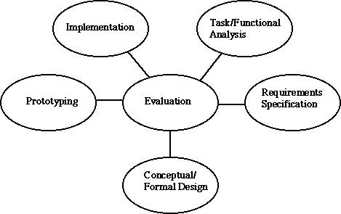
The Star Life-Cycle (Hix & Hartson, 1993)
At the center of the star life cycle is the very important evaluation stage. After every iteration, there is an evaluation process to determine the outcome of the last stage. Progress can be measured throughout the process. A range of evaluation strategies is needed to support this model

Slide 21
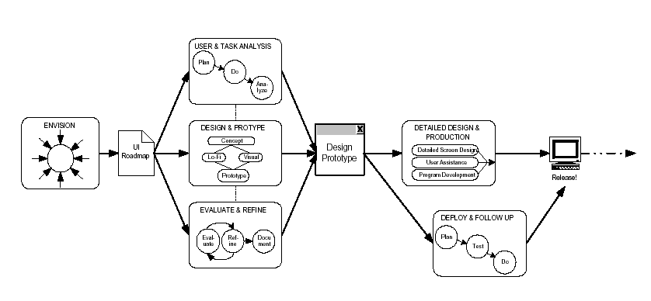
The LUCID Design Framework (Logical User Centered Interaction Design)
http://www.cognitics.com

Slide 22
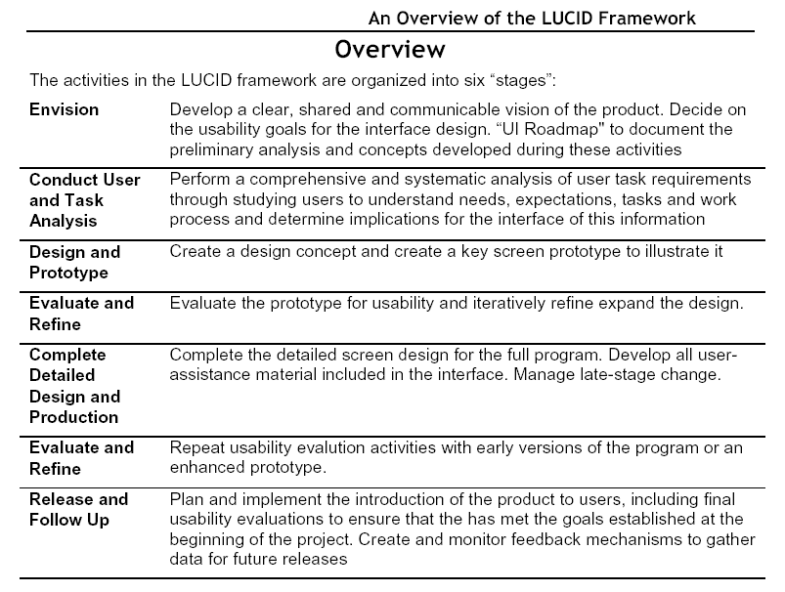

Slide 23
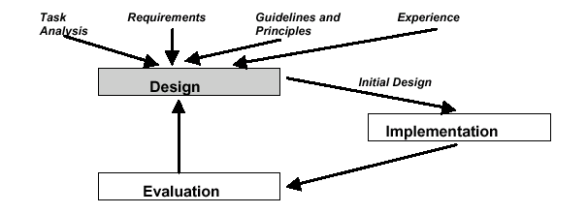
Iterative Design Using Prototypes
Generate a prototype of the design e.g. initial design from guidelines and
principles
Evaluate the design; Redesign to correct any errors; Build new prototype

Slide 24
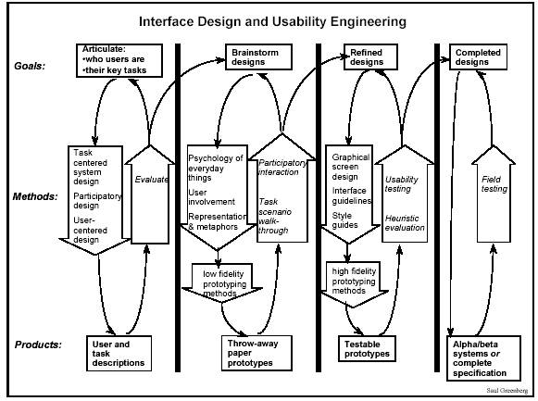
Interface Design and Usability Engineering (Saul Greenberg)

Slide 25
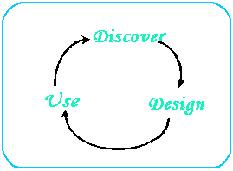
Discover, Design, Use (John Cato)
For designing web interfaces
User-Centered Web Design

